Slide 1
When the subjects of metadata embraces the statistical learning
Anlin Yang, East Asian Cataloging Librarian
University of Iowa Libraries

Slide 2
INVESTIGATION
The growing number of Chinese materials
The new change of subjects
IMPLEMENTATION
Current statistical learning methods/frameworks
The assumptions of statistical learning application on subjects of metadata
Notes:
Universally: important, but share some data. After, my challenges and choices on 2 aspects

Slide 3
The Number of Chinese Volumes in U.S. University Libraries
Public University Libraries (25 Institutions)
Source: CEAL Statistics Data

Slide 4
The Number of Chinese Volumes in U.S. University Libraries
Private University Libraries (16 Institutions)
Source: CEAL Statistics Data

Slide 5
The Satisfaction to Search Non-Roman Scripts
Satisfaction with using controlled English subjects to find Non-Roman scripts
Source: El-Sherbini, M., & Chen, S. (2011). An assessment of the need to provide non-Roman subject access to the library online catalog. Cataloging & Classification Quarterly, 49(6), 457-483.
http://dx.doi.org/10.1080/01639374.2011.603108

Slide 6
Some Controlled Vocabularies and Thesaurus Release Timeline
1898
1996
1998
LCSH
ERIC
Thesaurus
Getty Vocabularies
The Art & Architecture Thesaurus (AAT)
The Getty Thesaurus of Geographic Names (TGN)
The Cultural Objects Name Authority (CONA)
The Union List of Artist Names (ULAN)
For Education
1940
1997
2016
MeSH
Transportation
Research
Thesaurus
COAR Vocabularies
For Medicine
Resource type to identify the genre of a research resource: October 2016
Access mode to declare the degree of 'openness 'of a resource (draft): May 2017
Based on NCHRP 20-32(2)
Increasing update frequency
More detailed on subject classification

Slide 7
Why we need the statistical learning into the subjects of metadata?
The continuous growing number of Chinese materials
How fast we could manage those metadata?
The difficulties of language barries for searching Chinese resources
How easy we could swing between different languages?
The rapid changes on academic studies
How possible we could learn brand new academic knowledge continually?
Notes:
One hand: RDA, the other hand: original

Slide 8
Core Ideas For Us
Segmentation
Words / phrases discovery
Build lexicon
Notes:
One hand: RDA, the other hand: original

Slide 9
Segmentation
Machine reading
sentences
sentences
sentences
Grab by a prior dictionary
A ranking list of words
A prior dictionary
matching
Words
Word Dictionary Model (WDM)
Source: Olivier, D. C. (1968). Stochastic grammars and language acquisition mechanisms: a thesis. Harvard University.

Slide 10
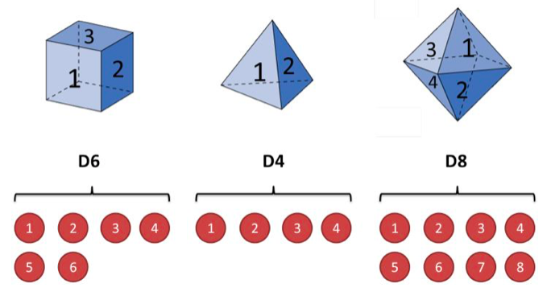
Words / Phrases Discovery
Down-top: Hidden Markov Model
Source: Ge, X., Pratt, W., & Smyth, P. (1999, August). Discovering Chinese words from unsegmented text. In Proceedings of the 22nd annual international ACM SIGIR conference on Research and development in information retrieval (pp. 271-272). ACM.

Slide 11
Words / Phrases Discovery
The ambiguity of Chinese words segmentation
“土地公有政策”(Public Ownership of Land Policy)
Correct: 土地 公有 政策 (land, public ownership, policy)
The possibility of words segmentation: 土地公 有 政策 (the earth god, has, policy)
Source: Chang, J. S., & Su, K. Y. (1997). An unsupervised iterative method for Chinese new lexicon extraction. International Journal of Computational Linguistics & Chinese Language Processing, Volume 2, Number 2, August 1997, 2(2), 97-148.

Slide 12
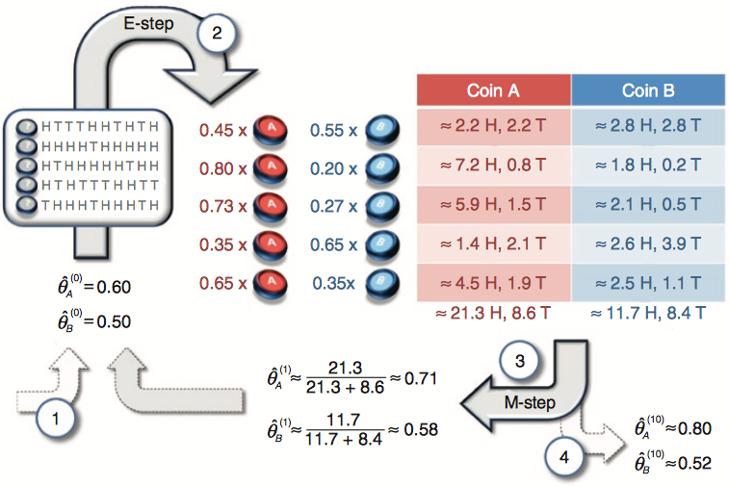
Segmentation
Top-down: Expectation-Maximization (EM) algorithm
Parameter
Rethink
Source: Do, C. B., & Batzoglou, S. (2008). What is the expectation maximization algorithm?. Nature biotechnology, 26(8), 897.
doi:10.1038/nbt1406

Slide 13
Segmentation
EM algorithm and its Chinese words catching
Grab a sentence
Assume as many as possible ways to segment
Share these segmentations to other sentences
Acquire the highest likelihood
A way of counting words
Source: Ge, X., Pratt, W., & Smyth, P. (1999, August). Discovering Chinese words from unsegmented text. In Proceedings of the 22nd annual international ACM SIGIR conference on Research and development in information retrieval (pp. 271-272). ACM.

Slide 14
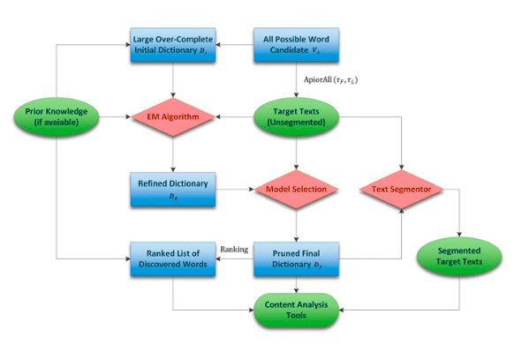
Build Lexicon
TopWORDS: The unsupervised analysis of Chinese texts
Source: Deng, K., Bol, P. K., Li, K. J., & Liu, J. S. (2016). On the unsupervised analysis of domain-specific Chinese texts. Proceedings of the National Academy of Sciences, 113(22), 6154-6159.
https://doi.org/10.1073/pnas.1516510113.

Slide 15
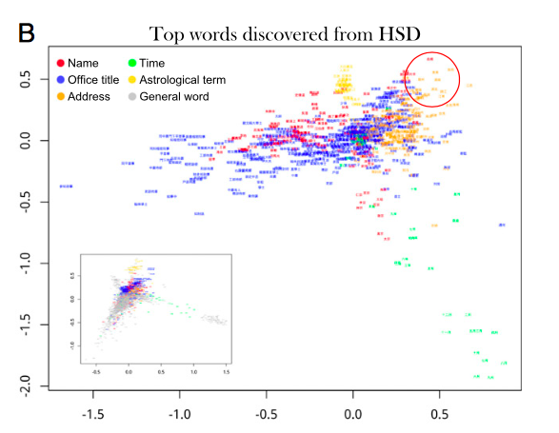
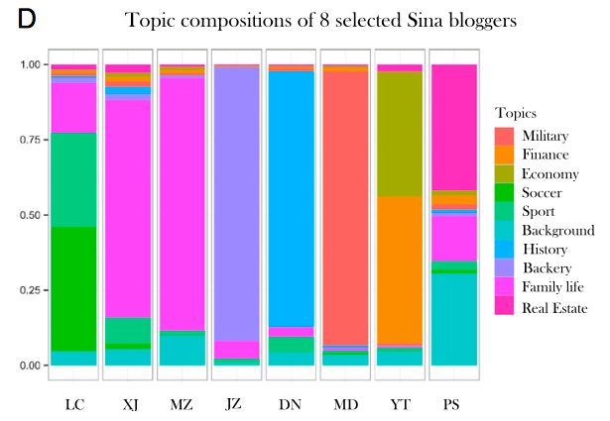
Build Lexicon
TopWORDS and its analysis results (search: Deng Lab, Tsinghua)
The word frequency of History of the Song Dynasty
The top topics from Sina bloggers
Source: Deng, K., Bol, P. K., Li, K. J., & Liu, J. S. (2016). On the unsupervised analysis of domain-specific Chinese texts. Proceedings of the National Academy of Sciences, 113(22), 6154-6159.
https://doi.org/10.1073/pnas.1516510113.

Slide 16
What could we get from statistical learning?
A lexicon or ranked list of words
To help us extract the subjects of metadata
Word frequency
To help us catch keywords and discard non-critical information
Text probable preferences and topics
To help us figure out the academic areas
Notes:
One hand: RDA, the other hand: original

Slide 17
Assumption of Frameworks
Integration
Procedures
Cooperation
Notes:
One hand: RDA, the other hand: original

Slide 18
Integration
Statistical learning
Library job
Word frequency, text preferences & topics
Source: Deng, K., Bol, P. K., Li, K. J., & Liu, J. S. (2016). On the unsupervised analysis of domain-specific Chinese texts. Proceedings of the National Academy of Sciences, 113(22), 6154-6159.
https://doi.org/10.1073/pnas.1516510113.

Slide 19
Procedures
Selection
Acquisition
run statistical learning machine
obtain word frequency, topic preference
Cataloging
subjects extraction
learn by machine
Marking / Shelving
subjects comparison
lexicon update

Slide 20
Cooperation
Report
Libraries
Statistical Learning Labs
Update

Slide 21
Thank you!
anlin-yang@uiowa.edu

